Slide 1
National Cyber League
Competition
Feb. 2025

Slide 2
What is NCL?
Why attend NCL?
Timeline and milestone
How I grade?
National Cyber League
Competition

Slide 3
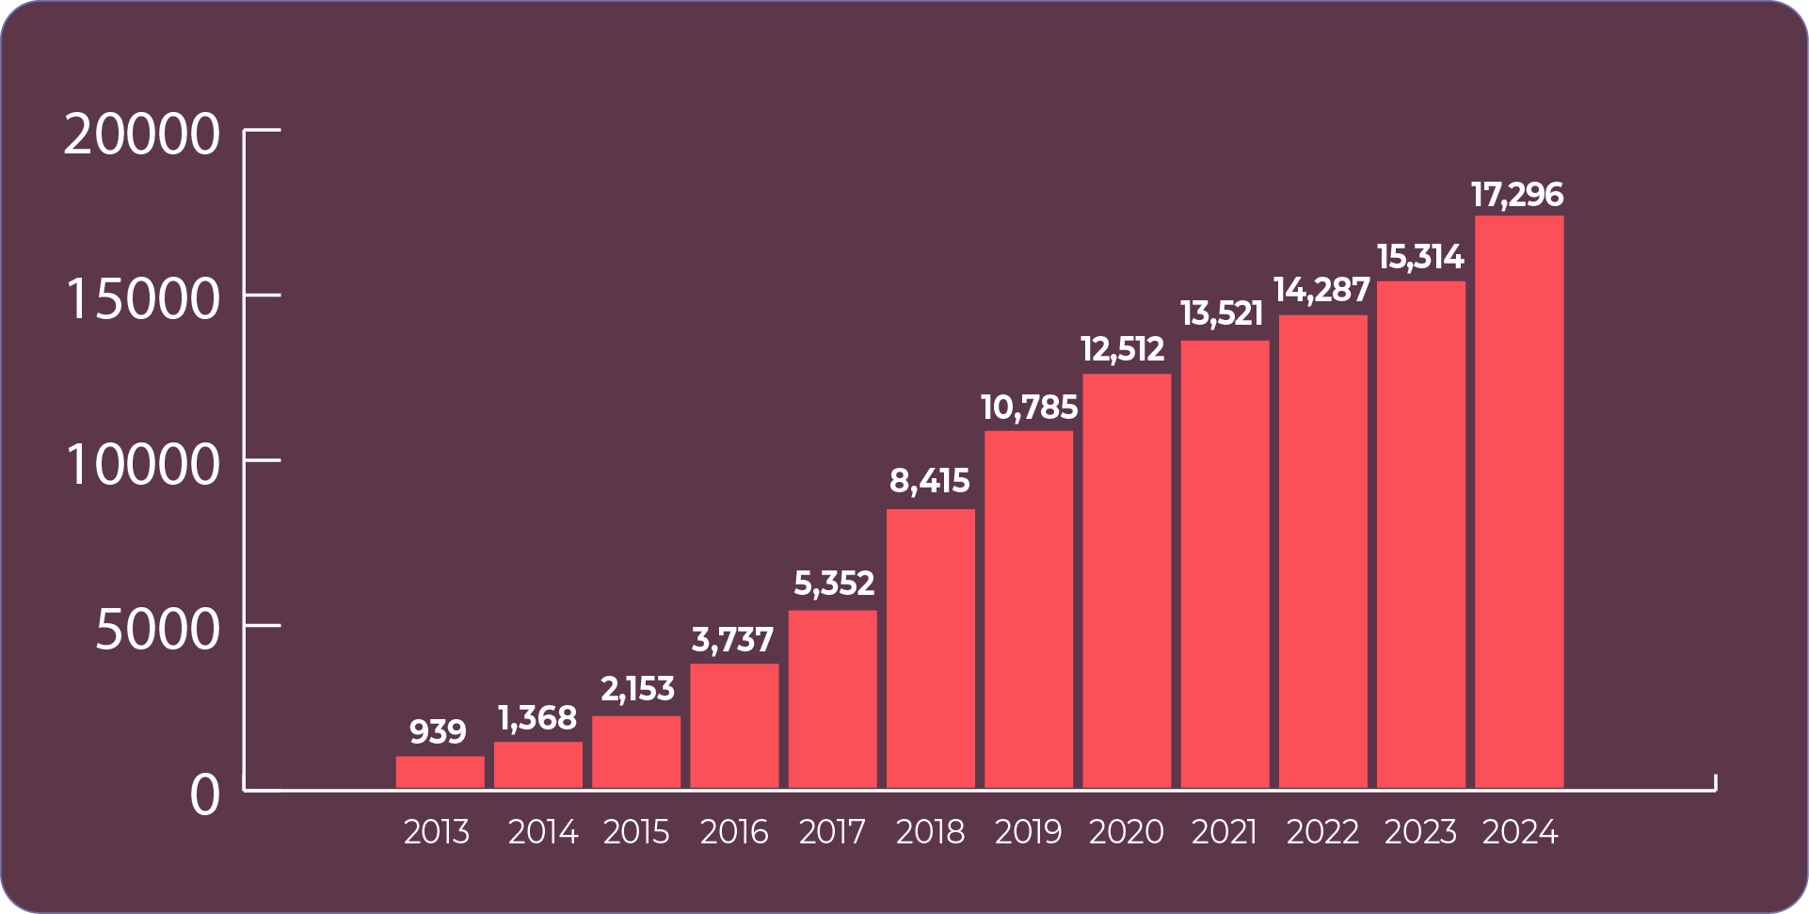
What is NCL?
The mission of the NCL Competition is to prepare the next generation of cybersecurity professionals by providing high school and college students, as well as their coaches, an online, safe platform of real-world cybersecurity challenges. We build pathways for students that lead to successful career placements in the cybersecurity field.
Number of NCL Players Through the Years

Slide 4
Who join NCL?
https://cyberskyline.com/data/schools
You are representing FGCU!
You are the first few teams from FGCU joining the NCL competition!

Slide 5
Why join NCL?
The students who participate in the NCL gain practical experience solving real-world challenges and earn a Scouting Report that provides evidence of their capabilities to potential employers. These benefits are uniquely valuable to individuals that are traditionally underrepresented within the cybersecurity industry. Our efforts to deliver these benefits is the primary way that we strive to improve diversity within the workforce.

Slide 6
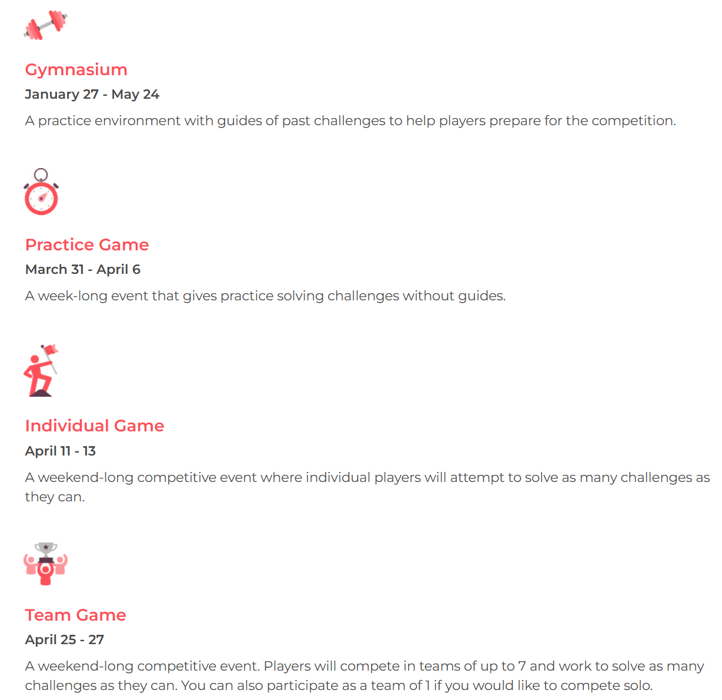
This Year’s NCL Details

Slide 7
NCL as a project
We will have two teams in our class joining the NCL competition this year.
Each team have 5 members
We will provide bucket tickets for all team members. So, join the competition is FREE!
You will also have fully access with a branch of cybersecurity resources, in the NCL practice portal.

Slide 8
Timeline and Milestones
Team leader meetings are also required for NCL teams.
Milestone 1: Instead of providing project plans, each team member should show me a screenshot on finishing partially practice questions inside their own gym portal.
Milestone 2: Each team member preparing slides on showing what you’ve learned from the gym. And your plans for the upcoming practice game happening Mar 31st to Apr 6th. As well as individual competition, happening Apr 11th to 13th.
Milestone 3: Each team member report their rankings, and conclude the good, the bad, and the ugly during the presentation. And detailed the plans for the final team competition, happening Apr 25th to 27th.
Milestone 4: In the final report, report your team ranking, write a report on describing what’s happening during the team competition. How many questions have been solved? Why you missed some points? What excited you most? Share your thoughts!

Slide 9
Final Report - Share your team’s stories!
Tell Your NCL Journey:
Introduction:
  Share your team's goals and expectations before the competition.
  What inspired your participation?
The Journey:
  Describe your experiences during the competition.
  Highlight memorable moments, challenges, and breakthroughs.
Team Dynamics:
  How did your team collaborate?
  Share examples of problem-solving and teamwork.
Lessons Learned:
  Reflect on the skills gained, challenges overcome, and personal growth.
Future Aspirations:
  How will this experience shape your future in cybersecurity

Slide 10
More surprises await you to discover!

